Slide 1
Overview
Data Mining for Business Analytics in R
Adapted from
Shmueli, Bruce, Yahav, Patel & Lichtendahl

Slide 2
Terms and notations
Algorithm A specific procedure used to implement a particular data mining technique: classification tree, discriminant analysis, and the like.
Attribute see Predictor.
Case see Observation.
Confidence A performance measure in association rules of the type “IF A and B are purchased, THEN C is also purchased.” Confidence is the conditional probability that C will be purchased IF A and B are purchased.
Confidence also has a broader meaning in statistics (confidence interval), concerning the degree of error in an estimate that results from selecting one sample as opposed to another.
Dependent Variable see Response.
Estimation see Prediction.

Slide 3
Terms and notations continued
Feature see Predictor.
Holdout Data (or holdout set) A sample of data not used in fitting a model, but instead used to assess the performance of that model. This book uses the terms validation set and test set instead of holdout set.
Input Variable see Predictor.
Model An algorithm as applied to a dataset, complete with its settings (many of the algorithms have parameters that the user can adjust).
Observation The unit of analysis on which the measurements are taken (a customer, a transaction, etc.), also called instance, sample, example, case, record, pattern, or row. In spreadsheets, each row typically represents a record; each column, a variable. Note that the use of the term “sample” here is different from its usual meaning in statistics, where it refers to a collection of observations.

Slide 4
Terms and notations continued
Outcome Variable see Response.
Output Variable see Response.
P (A j B) The conditional probability of event A occurring given that event B has occurred, read as “the probability that A will occur given that B has occurred.”
Prediction The prediction of the numerical value of a continuous output variable; also called estimation.
Predictor A variable, usually denoted by X, used as an input into a predictive model, also called a feature, input variable, independent variable, or from a database perspective, a field.
Profile A set of measurements on an observation (e.g., the height, weight, and age of a person).
Record see Observation.

Slide 5
Terms and notations continued
Response A variable, usually denoted by Y , which is the variable being predicted in supervised learning, also called dependent variable, output variable, target variable, or outcome variable.
Sample In the statistical community, “sample” means a collection of observations. In the machine learning community, “sample” can mean a single observation.
Score A predicted value or class. Scoring new data means using a model developed with training data to predict output values in new data.
Success Class The class of interest in a binary outcome (e.g., purchasers in the outcome purchase/no purchase).
Supervised Learning The process of providing an algorithm (logistic regression, regression tree, etc.) with records in which an output variable of interest is known and the algorithm “learns” how to predict this value with new records where the output is unknown.

Slide 6
Terms and notations continued
Target see Response.
Test Data (or test set) The portion of the data used only at the end of the model building and selection process to assess how well the final model might perform on new data.
Training Data (or training set) The portion of the data used to fit a model.
Unsupervised Learning An analysis in which one attempts to learn patterns in the data other than predicting an output value of interest.
Validation Data (or validation set) The portion of the data used to assess how well the model fits, to adjust models, and to select the best model from among those that have been tried.
Variable Any measurement on the records, including both the input (X) variables and the output (Y ) variable.

Slide 7
Core Ideas in Data Mining
Classification
Prediction
Association Rules & Recommenders
Data & Dimension Reduction
Data Exploration
Visualization

Slide 8
Paradigms for Data Mining (variations)
SEMMA (from SAS)
Sample
Explore
Modify
Model
Assess
CRISP-DM (SPSS/IBM)
Business Understanding
Data Understanding
Data Preparation
Modeling
Evaluation
Deployment

Slide 9
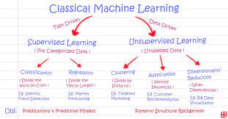
Machine learning

Slide 10
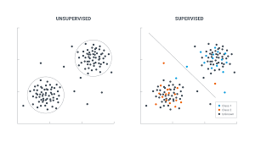
Supervised Learning
Goal: Predict a single “target” or “outcome” variable
Training data, where target value is known
Score to data where value is not known
Methods: Classification and Prediction

Slide 11
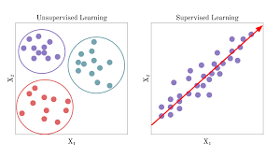
Unsupervised Learning
Goal: Segment data into meaningful segments; detect patterns
There is no target (outcome) variable to predict or classify
Methods: Association rules, data reduction & exploration, visualization

Slide 12
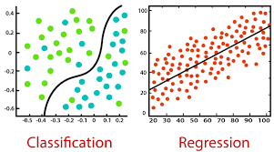
Supervised: Classification
Goal: Predict categorical target (outcome) variable
Examples: Purchase/no purchase, fraud/no fraud, creditworthy/not creditworthy…
Each row is a case (customer, tax return, applicant)
Each column is a variable
Target variable is often binary (yes/no)

Slide 13
Supervised: Prediction
Goal: Predict numerical target (outcome) variable
Examples: sales, revenue, performance
As in classification:
Each row is a case (customer, tax return, applicant)
Each column is a variable
Taken together, classification and prediction constitute “predictive analytics”

Slide 14
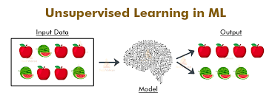
Unsupervised: Association Rules
Goal: Produce rules that define “what goes with what”
Example: “If X was purchased, Y was also purchased”
Rows are transactions
Used in recommender systems – “Our records show you bought X, you may also like Y”
Also called “affinity analysis”

Slide 15
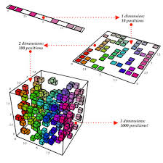
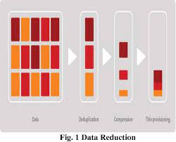
Unsupervised: Data Reduction
Distillation of complex/large data into simpler/smaller data
Reducing the number of variables/columns (e.g., principal components)
Reducing the number of records/rows (e.g., clustering)

Slide 16
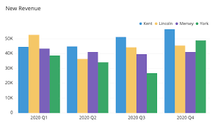
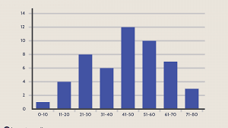
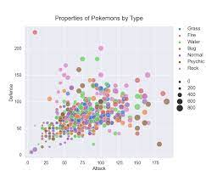
Unsupervised: Data Visualization
Graphs and plots of data
Histograms, boxplots, bar charts, scatterplots
Especially useful to examine relationships between pairs of variables

Slide 17
Data Exploration
Data sets are typically large, complex & messy
Need to review the data to help refine the task
Use techniques of Reduction and Visualization

Slide 18
The Process of Data Mining

Slide 19
Steps in Data Mining
Define/understand purpose
Obtain data (may involve random sampling)
Explore, clean, pre-process data
Reduce the data; if supervised DM, partition it
Specify task (classification, clustering, etc.)
Choose the techniques (regression, CART, neural networks, etc.)
Iterative implementation and “tuning”
Assess results – compare models
Deploy best model

Slide 20
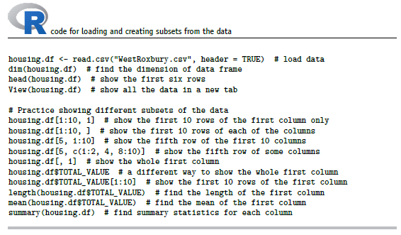
Preliminary Exploration in R loading data, viewing it, summary statistics

Slide 21
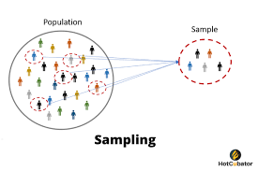
Obtaining Data: Sampling
Data mining typically deals with huge databases
For piloting/prototyping, algorithms and models are typically applied to a sample from a database, to produce statistically-valid results
Once you develop and select a final model, you use it to “score” (predict values or classes for) the observations in the larger database

Slide 22
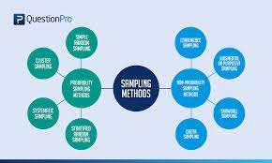
Rare Event Oversampling
Often the event of interest is rare
Examples: response to mailing, fraud in taxes, …
Sampling may yield too few “interesting” cases to effectively train a model
A popular solution: oversample the rare cases to obtain a more balanced training set
Later, need to adjust results for the oversampling

Slide 23
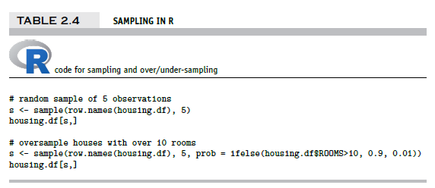
Sampling & Oversampling

Slide 24
Types of Variables
Determine the types of pre-processing needed, and algorithms used
Main distinction: Categorical vs. numeric
Numeric
Continuous
Integer
Categorical
Ordered (low, medium, high)
Unordered (male, female)

Slide 25
Variable handling
Numeric
Most algorithms can handle numeric data
May occasionally need to “bin” into categories
Categorical
Naïve Bayes can use as-is
In most other algorithms, must create binary dummies (number of dummies = number of categories – 1) [see Table 2.6 for R code]

Slide 26
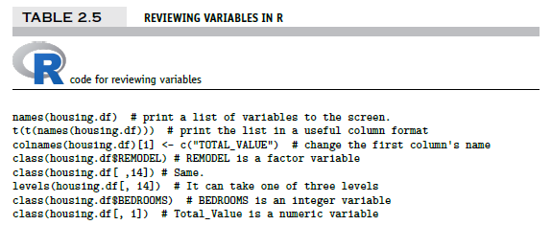
Reviewing Variables in R
a double matrix transpose using t (transpose) function
output on next slide…

Slide 27
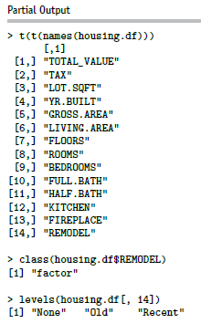
Output of code on previous slide

Slide 28
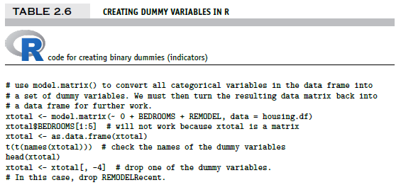
Creating binary dummies
#now, put it all together again, drop original REMODEL from the data housing.df <- cbind(housing.df[, -c(9, 14)], xtotal) t(t(names(housing.df)))
output on next slide…

Slide 29
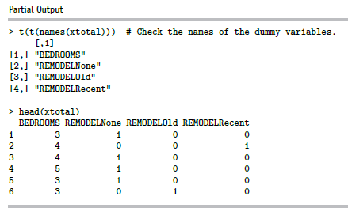
Creating Binary Dummies – Output
Note: R’s lm function automatically creates dummies, so you can skip dummy creation when using lm

Slide 30
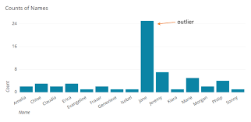
Detecting Outliers
An outlier is an observation that is “extreme”, being distant from the rest of the data (definition of “distant” is deliberately vague)
Outliers can have disproportionate influence on models (a problem if it is spurious)
An important step in data pre-processing is detecting outliers
Once detected, domain knowledge is required to determine if it is an error, or truly extreme.

Slide 31
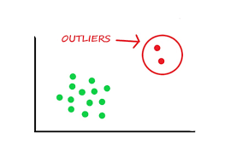
Detecting Outliers
In some contexts, finding outliers is the purpose of the DM exercise (airport security screening). This is called “anomaly detection”.
Notes:
31

Slide 32
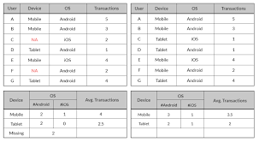
Missing data

Slide 33
Handling Missing Data
Most algorithms will not process records with missing values. Default is to drop those records.
Solution 1: Omission
If a small number of records have missing values, can omit them
If many records are missing values on a small set of variables, can drop those variables (or use proxies)
If many records have missing values, omission is not practical
Solution 2: Imputation [see Table 2.7 for R code]
Replace missing values with reasonable substitutes
Lets you keep the record and use the rest of its (non-missing) information

Slide 34
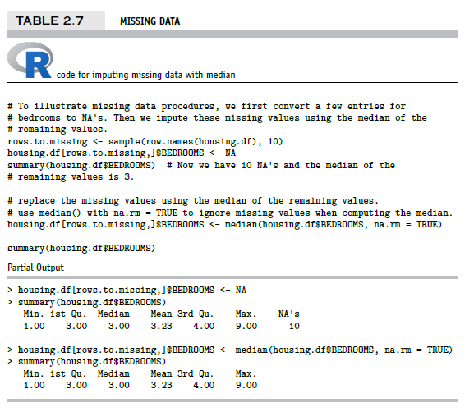
Replacing Missing Data with Median

Slide 35
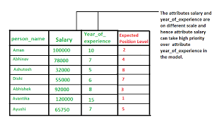
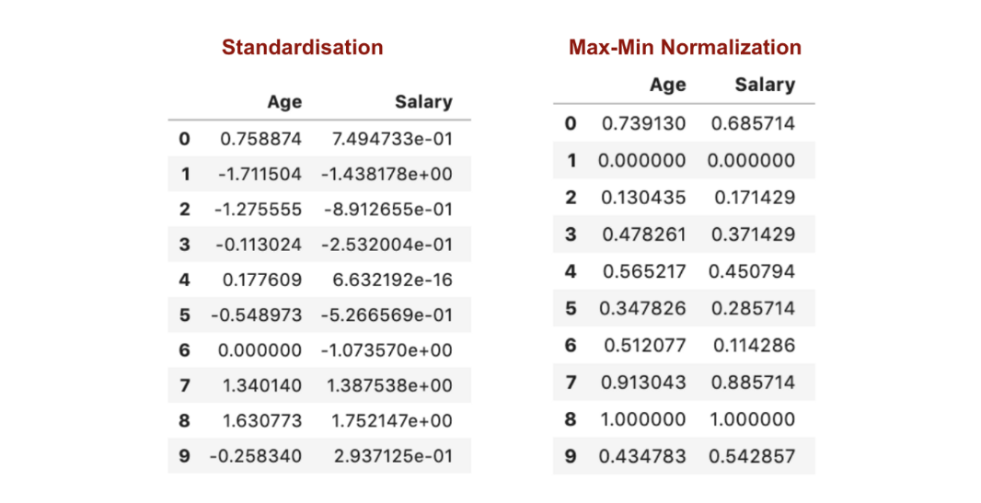
Normalizing (Standardizing) Data
Used in some techniques when variables with the largest scales would dominate and skew results
Puts all variables on same scale
Normalizing function: Subtract mean and divide by standard deviation
Alternative function: scale to 0-1 by subtracting minimum and dividing by the range
Useful when the data contain dummies and numeric

Slide 36
The Problem of Overfitting
Statistical models can produce highly complex explanations of relationships between variables
The “fit” may be excellent
When used with new data, models of great complexity do not do so well.
Notes:
36

Slide 37
100% fit – not useful for new data
Notes:
37

Slide 38
Overfitting (cont.)
Causes:
Too many predictors
A model with too many parameters
Trying many different models
Consequence: Deployed model will not work as well as expected with completely new data.
Notes:
38

Slide 39
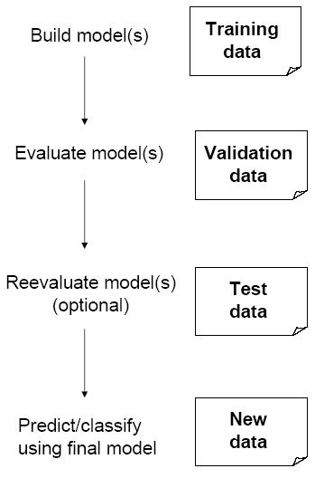
Partitioning the Data
Problem: How well will our model perform with new data?
Solution: Separate data into two parts
Training partition to develop the model
Validation partition to implement the model and evaluate its performance on “new” data
Addresses the issue of overfitting

Slide 40
Test Partition
When a model is developed on training data, it can overfit the training data (hence need to assess on validation)
Assessing multiple models on same validation data can overfit validation data
Some methods use the validation data to choose a parameter. This too can lead to overfitting the validation data
Solution: final selected model is applied to a test partition to give unbiased estimate of its performance on new data

Slide 41
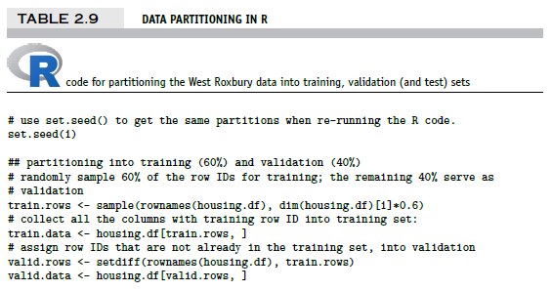
Partitioning the Data

Slide 42
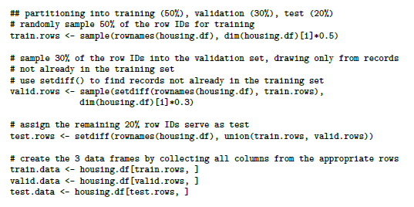
Partitioning the Data into 3 sets

Slide 43
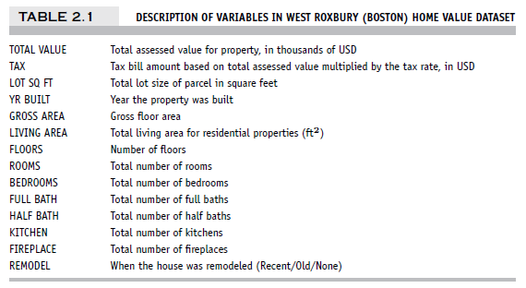
Example – Linear Regression West Roxbury Housing Data

Slide 44
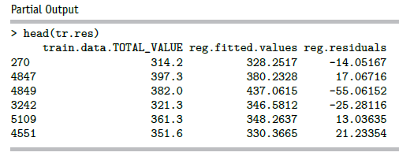
Fit model to the training data
Use lm function (“linear model”):
reg <- lm(TOTAL_VALUE ~ ., data = housing.df, subset = train.rows)
“Scoring” data is getting predicted (= “fitted) values; here for the training data:
reg <- lm(TOTAL_VALUE ~ .-TAX, data = housing.df, subset = train.rows) # remove TAX
tr.res <- data.frame(train.data$TOTAL_VALUE, reg$fitted.values, reg$residuals)
head(tr.res)

Slide 45
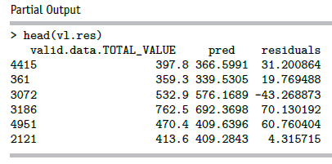
Scoring the validation data
pred <- predict(reg, newdata = valid.data)
vl.res <- data.frame(valid.data$TOTAL_VALUE, pred, residuals =
valid.data$TOTAL_VALUE - pred)
head(vl.res)

Slide 46
Assess accuracy
For the validation data:
library(forecast)
accuracy(pred, valid.data$TOTAL_VALUE)
Output:
ME RMSE MAE MPE MAPE
Test set -1.22575 43.29939 32.26393 -1.376272 8.414937
Potential confusion: the label Test set is used by the forecast package to refer to the data used in the analysis and does not refer to the test partition created earlier. The forecast package is used in all types of modeling analysis, not just data mining, hence the conflicting terminology.

Slide 47
Error metrics
Error = actual – predicted
ME = Mean error
RMSE = Root-mean-squared error = Square root of average squared error
MAE = Mean absolute error
MPE = Mean percentage error
MAPE = Mean absolute percentage error

Slide 48
Summary
Data Mining consists of supervised methods (Classification & Prediction) and unsupervised methods (Association Rules, Data Reduction, Data Exploration & Visualization)
Before algorithms can be applied, data must be explored and pre-processed
To evaluate performance and to avoid overfitting, data partitioning is used
Models are fit to the training partition and assessed on the validation and test partitions
Data mining methods are usually applied to a sample from a large database, and then the best model is used to score the entire database

